Slide 1
Energy Usage Report C4T2
Yuliya Bowen

Slide 2
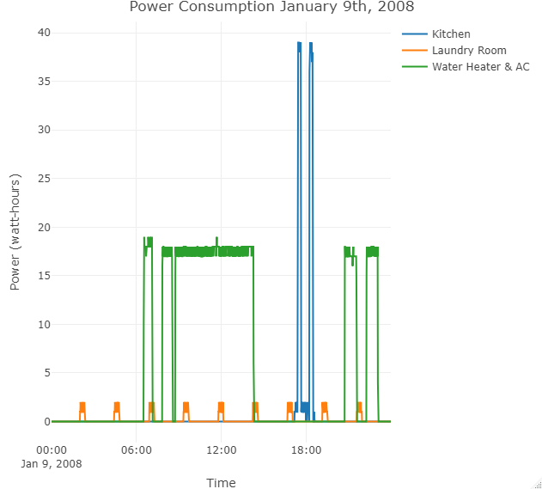
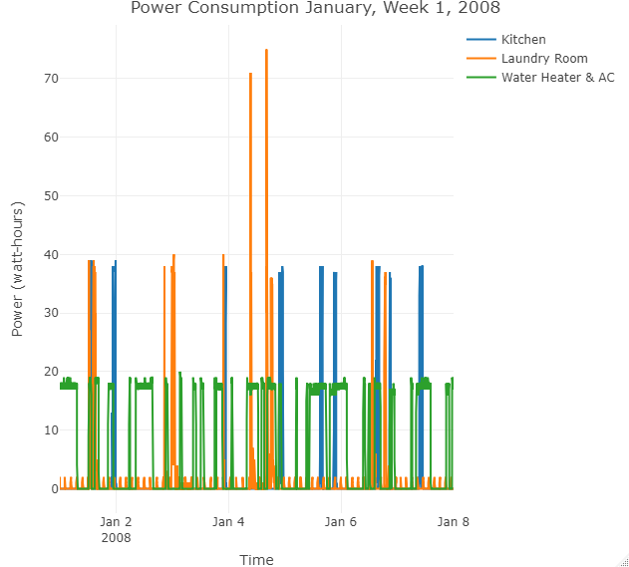
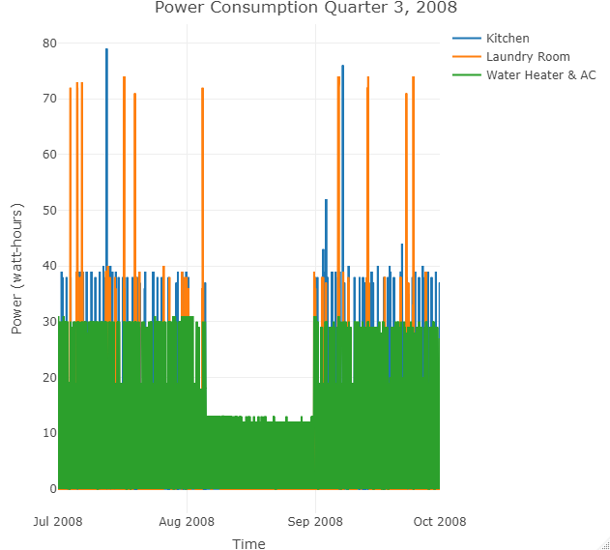
Energy Usage Report
Power consumption extracted from the dataset on different days in 2008.

Slide 3
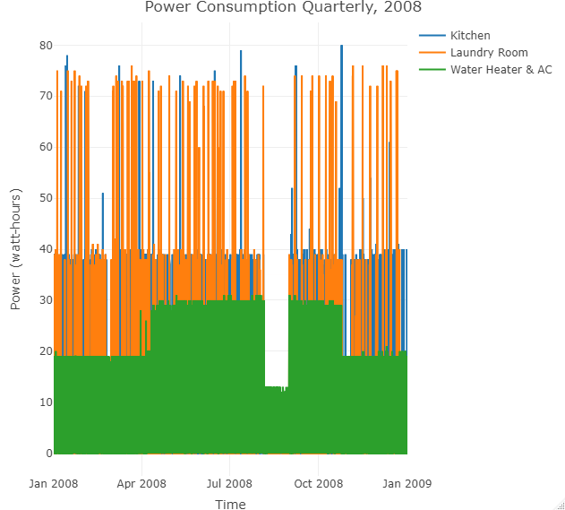
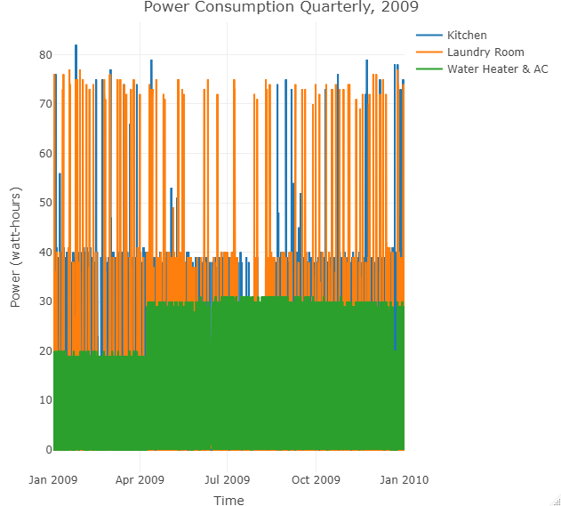
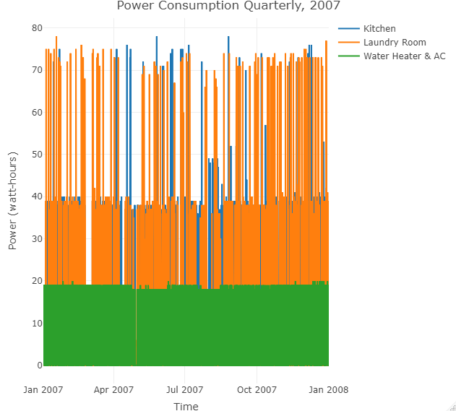
Energy Usage Report
Comparing power consumption from a given dataset for years 2007-2009 quarterly. It is hard to see the pattern of power usage by 3 different sub meters.

Slide 4
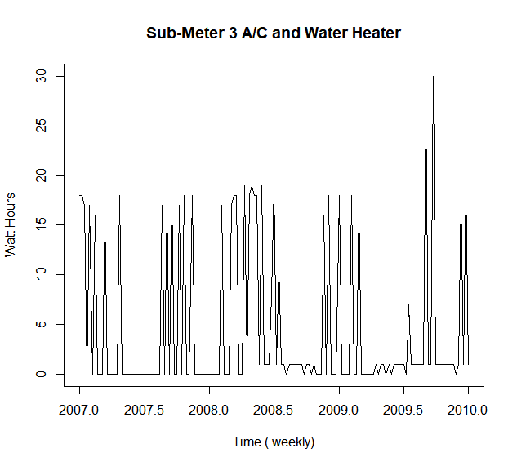
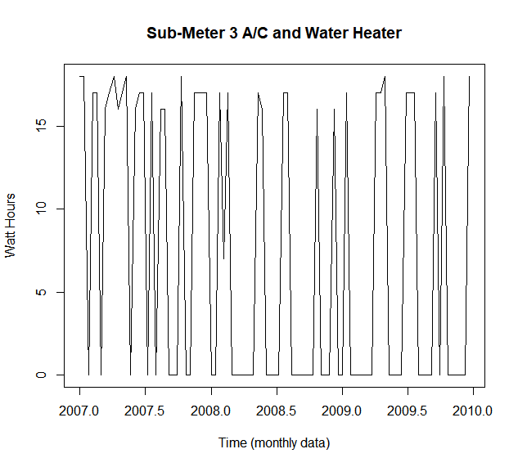
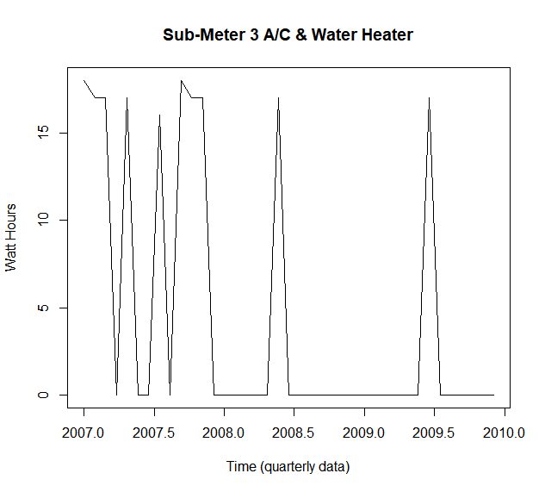
Energy Usage Report TS SM 3
Looking at the graphs of Sub Meter 3 it is difficult to see a trend in energy usage in the weekly and monthly graphs. There is a bit of a pattern displayed in the monthly TS graph, but it is not that obvious.

Slide 5
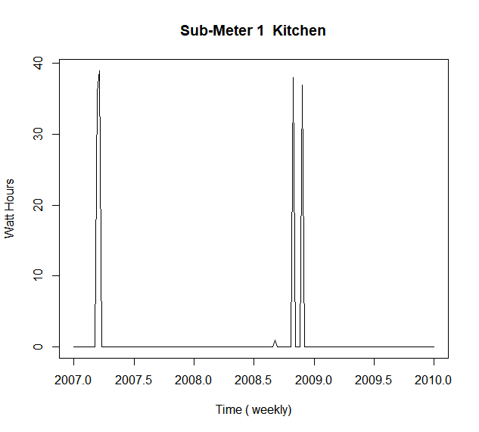
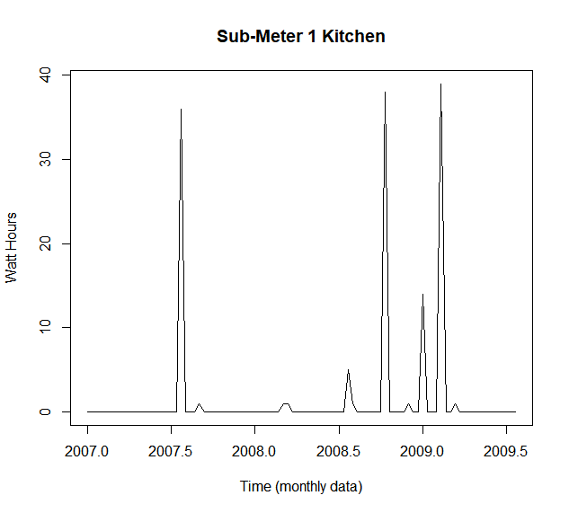
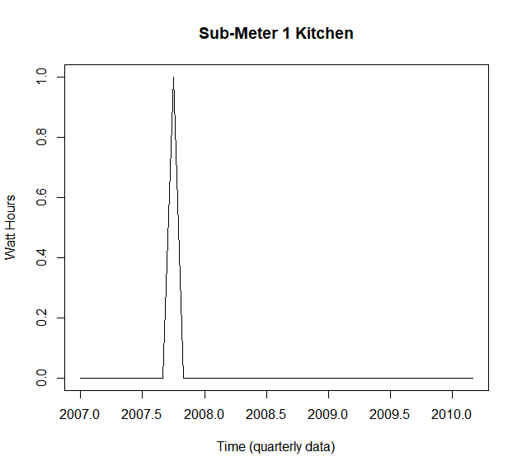
Energy Usage Report TS SM 1
Looking at the graphs of Sub Meter 1 it is difficult to see a trend in energy usage in any of the 3 time series graphs.

Slide 6
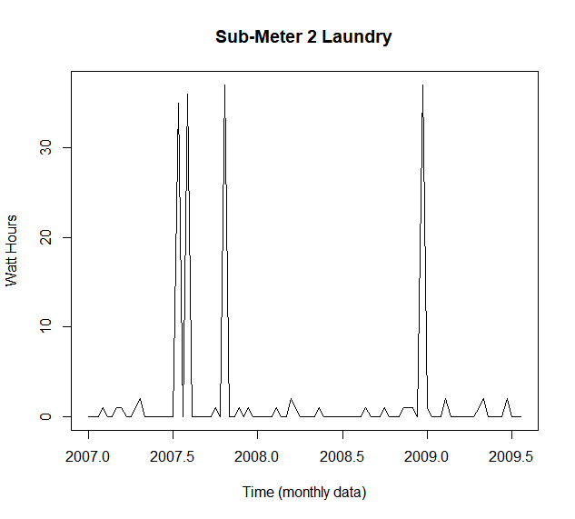
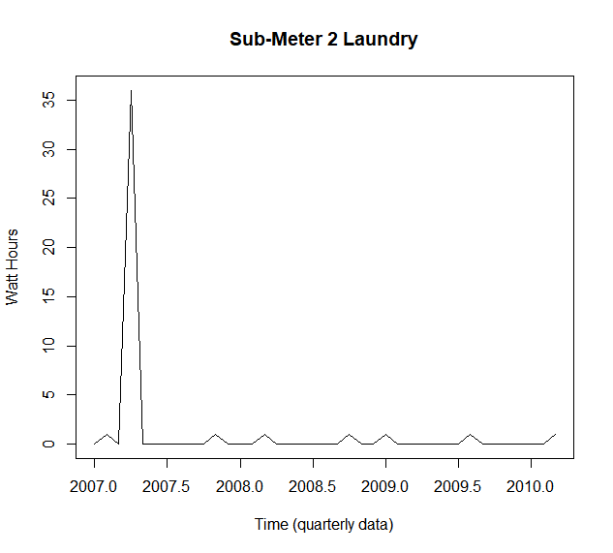
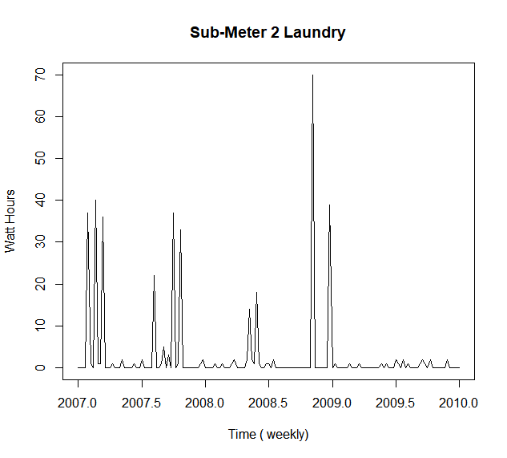
Energy Usage Report TS SM 2
Looking at the graphs of Sub Meter 2, that is a laundry room, it is hard to see a trend in energy usage in weekly, monthly or quarterly time series graphs.

Slide 7
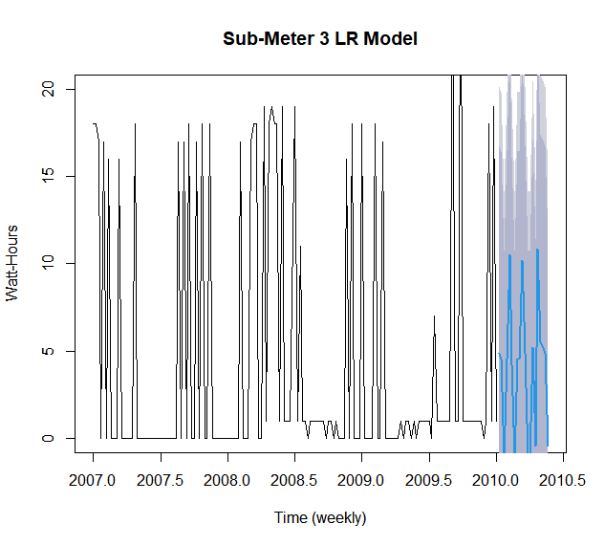
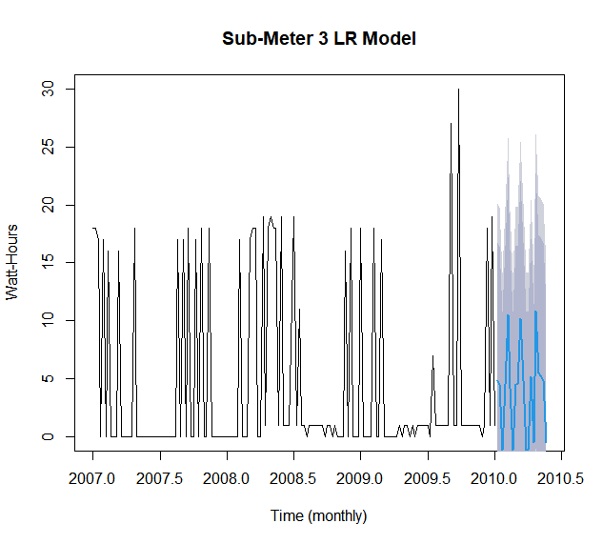
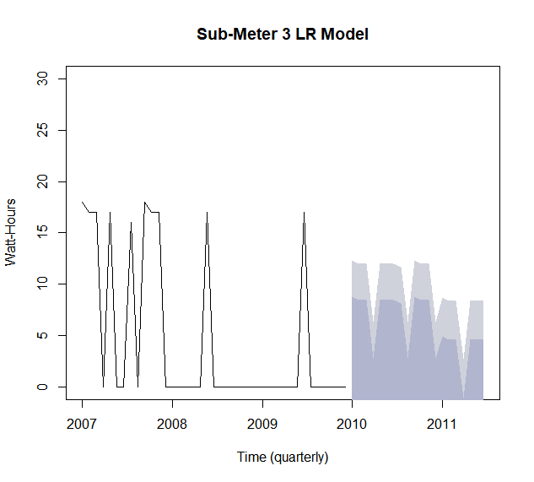
Energy Usage Report LR SM 3
Looking at the Linear Regression graphs of Sub Meter 3 from all 3 time series, we can tell that it will be challenging to predict energy usage based on the data set given. The statistical measure r- squared is very low for all threes time series. .26 for weekly, .32 for monthly and . 35 for quarterly time frequencies.

Slide 8
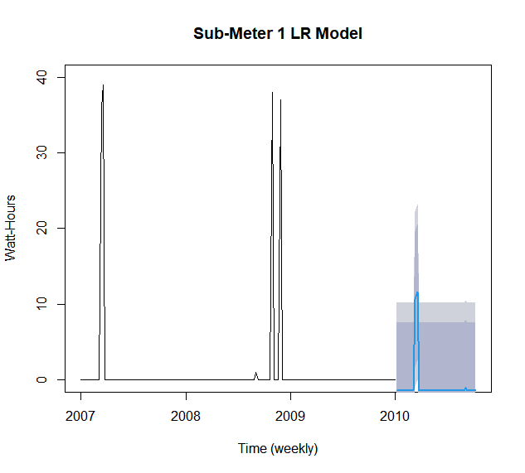
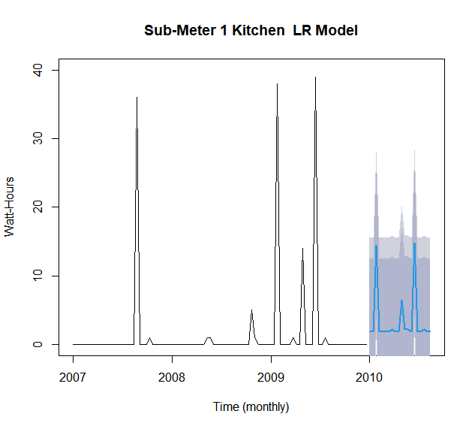
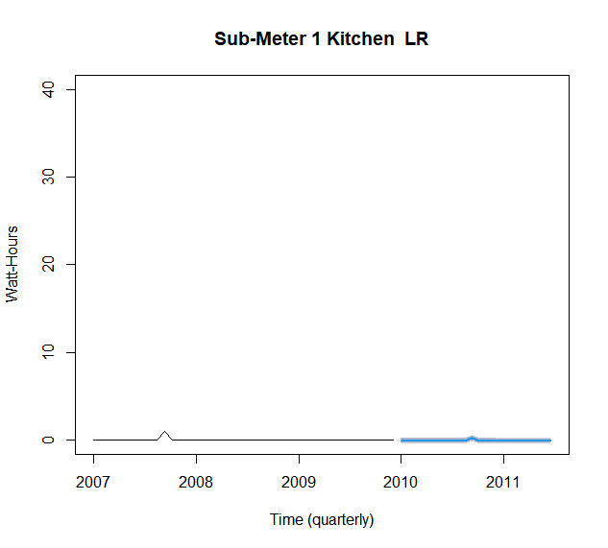
Energy Usage Report LR SM 1
Linear Regression graphs of Sub Meter 1 from all 3 time series, represent very little or no possibility of predicting energy usage. The statistical measure (r- squared) measures were .35 for weekly, .31 for monthly and . 35 for quarterly time frequencies, which are very low.

Slide 9
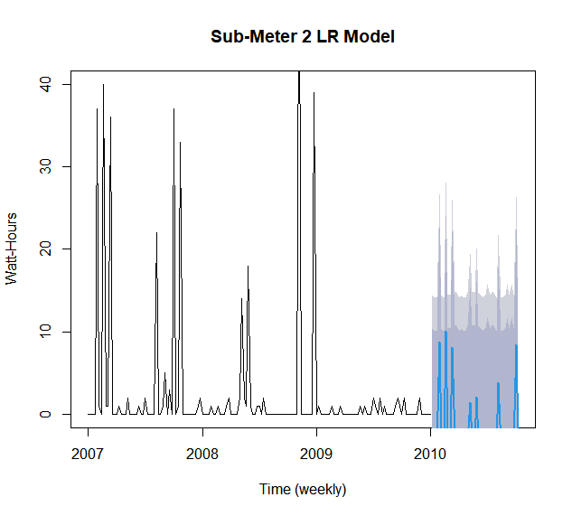
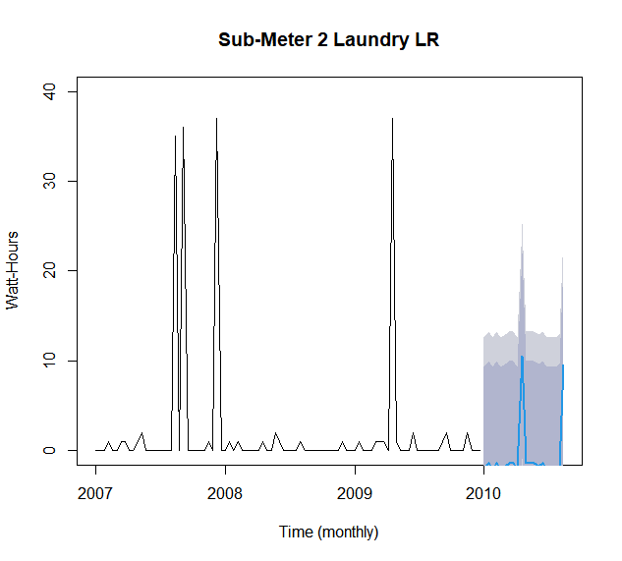
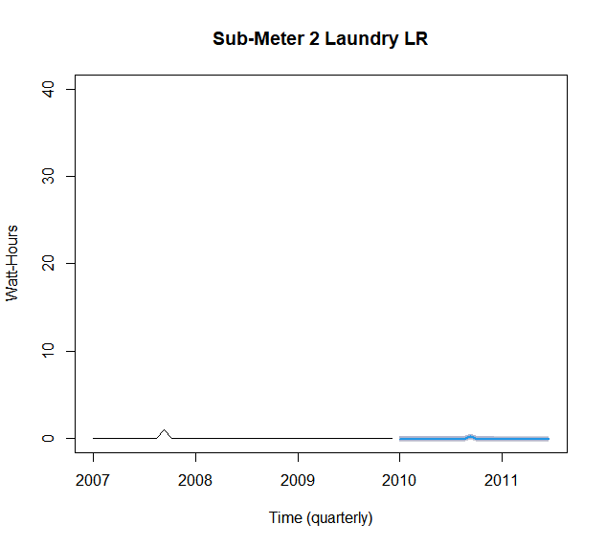
Energy Usage Report LR SM 2
All 3 time series graphs represent the Linear Regression analysis for sub meter 2. The statistical measure r- squared measures were .35 for weekly, .31 for monthly, and .34 for quarterly time frequencies, which are very low.

Slide 10
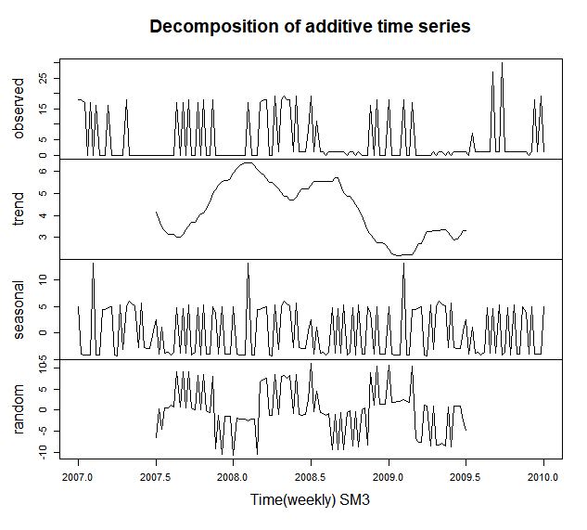
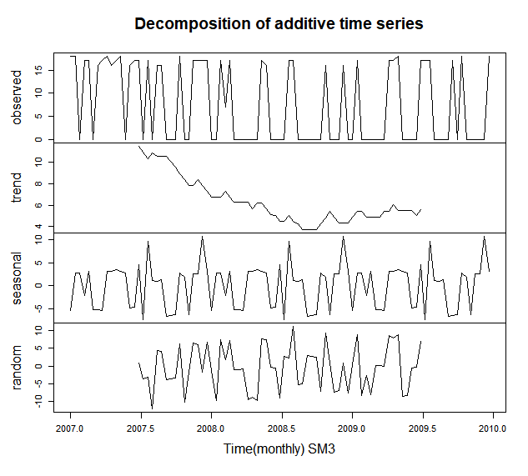
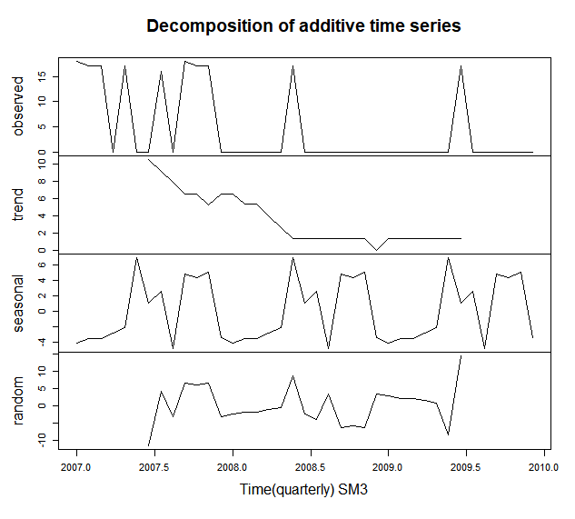
Energy Usage Report Decomposition SM 3
The weekly graph for Sub Meter 3 shows that energy usage increased through 2007 & 2008 but then decreased towards the beginning of 2009. After that, usage slightly increased during 2009. For monthly frequency, the usage decreased through 2009 and had a very slight increase in 2009.

Slide 11
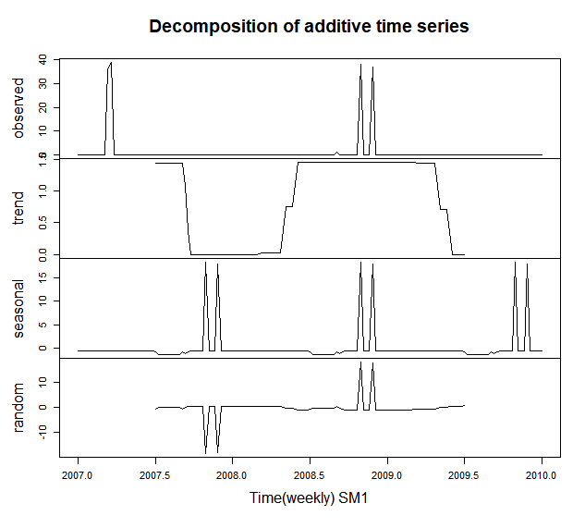
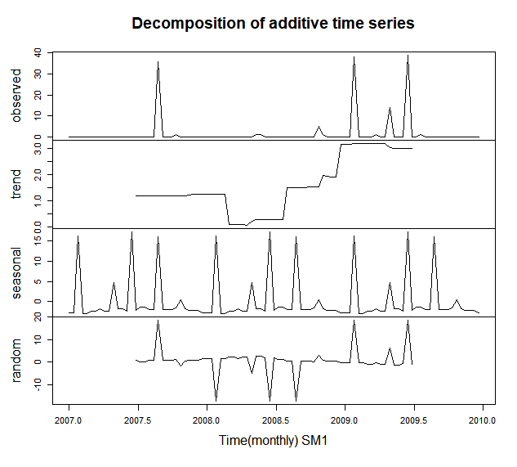
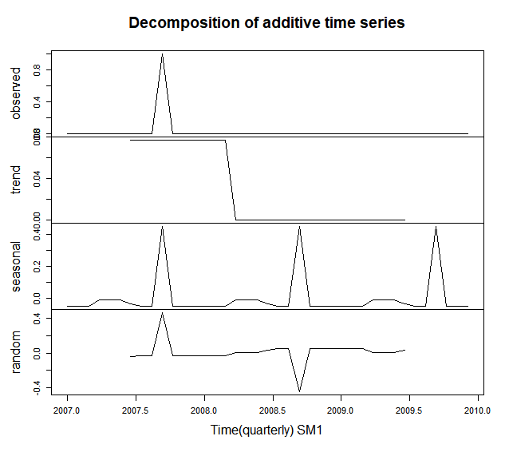
Energy Usage Report Decomposition SM 1
The weekly graph for Sub Meter 1 shows an increase and decrease of usage of energy throughout the 2007-2009. On a monthly graph we see that the usage of energy was increasing after 2008. For quarterly frequency, the usage was decreasing through 2008 and then plateaued after that.

Slide 12
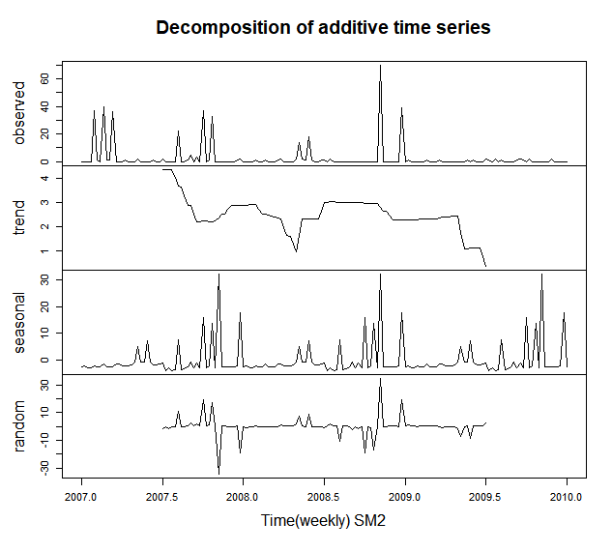
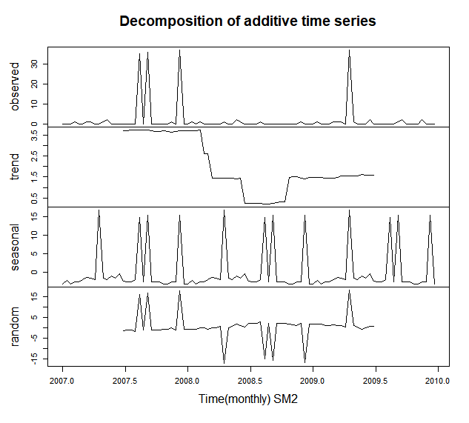
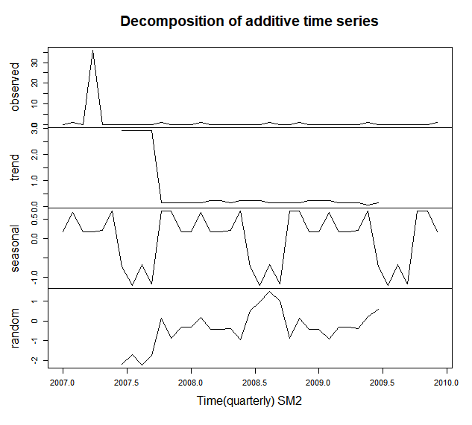
Energy Usage Report Decomposition SM 2
The weekly graph for Sub Meter 2 shows a decreasing trend until the first half of 2008, then a slight increase and then plateauing for a bit, and then a decrease in the second half of 2009. On a monthly graph we see a decrease until almost 2009 and then a slight increase .

Slide 13
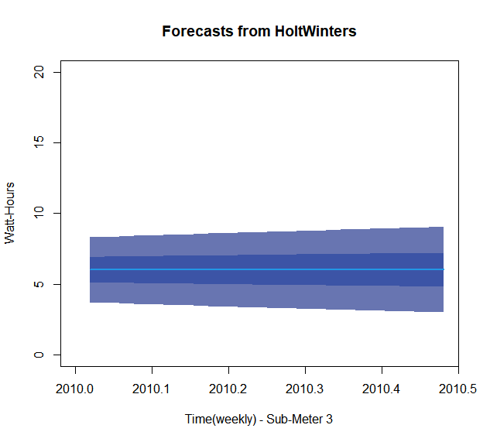

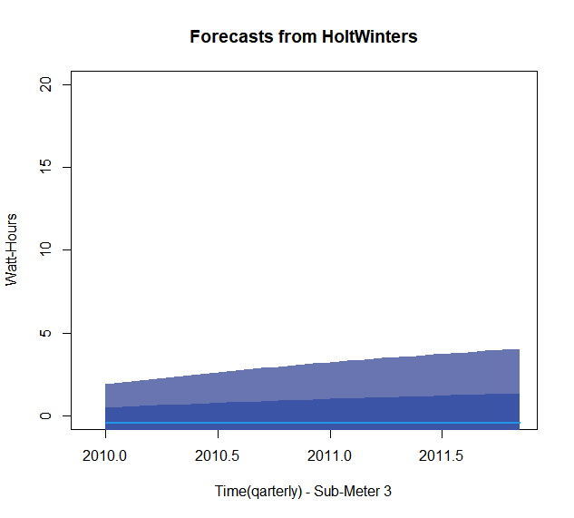
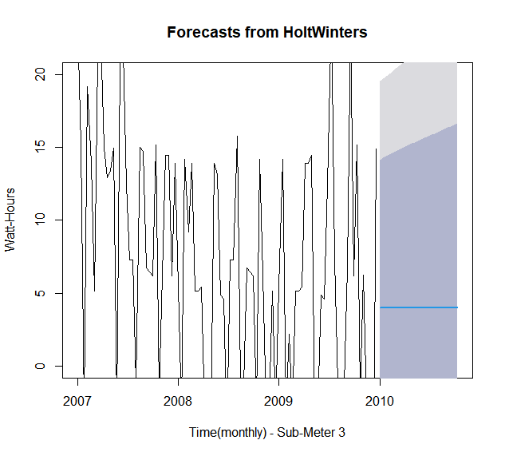
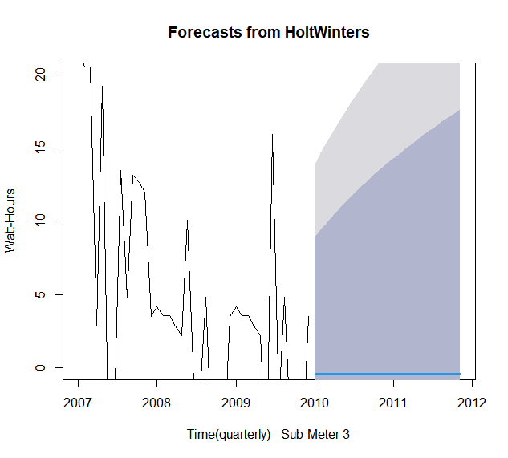
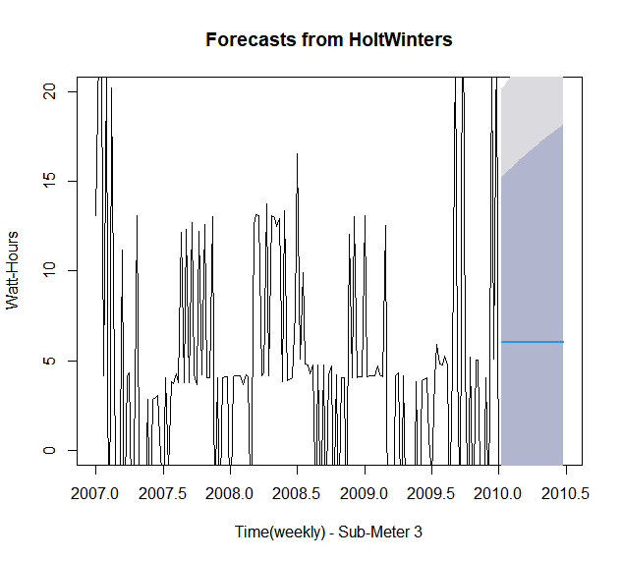
Holt Winter Forecast SM 3
To predict the behavior of a sequence of values over time we used the HW Forecast for all three frequencies. With a confidence level of 80% the P value was the highest for SM 3 for the weekly trend. But that will not tell us much about how to accommodate apparent energy usage in a better way. The P value for both monthly and quarterly frequencies were very low.

Slide 14
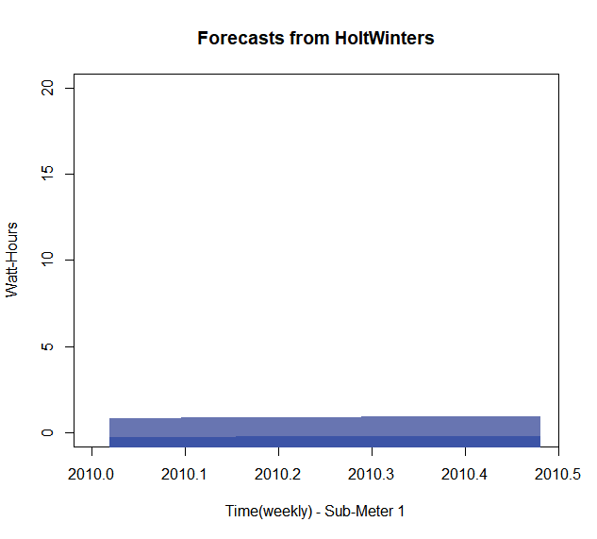

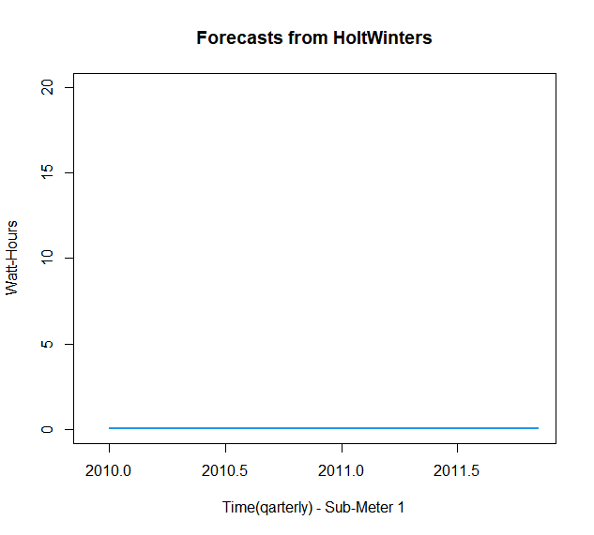
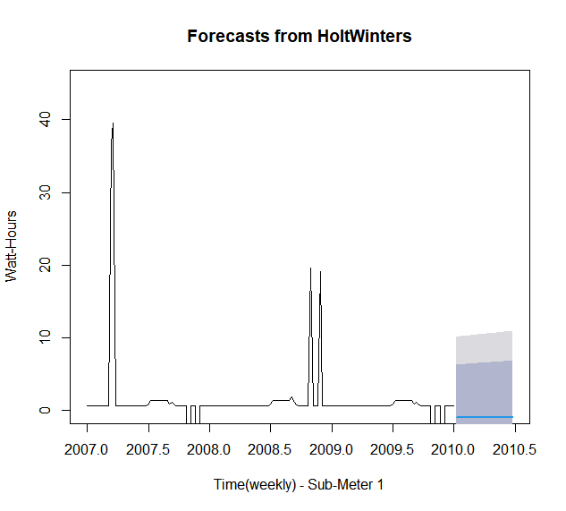

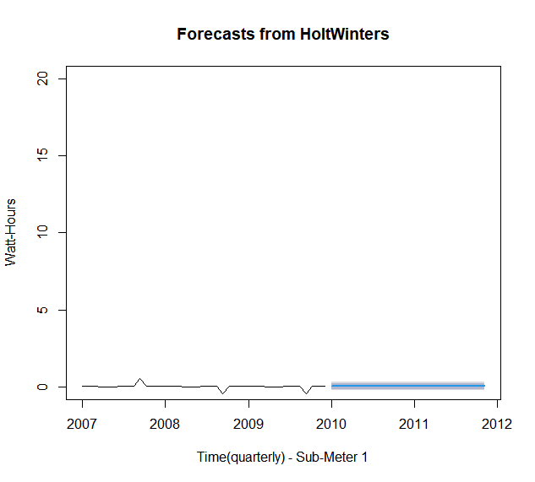
Holt Winter Forecast SM 1
P - value for all 3 frequencies for SM 1 were very low for HW forecast.

Slide 15
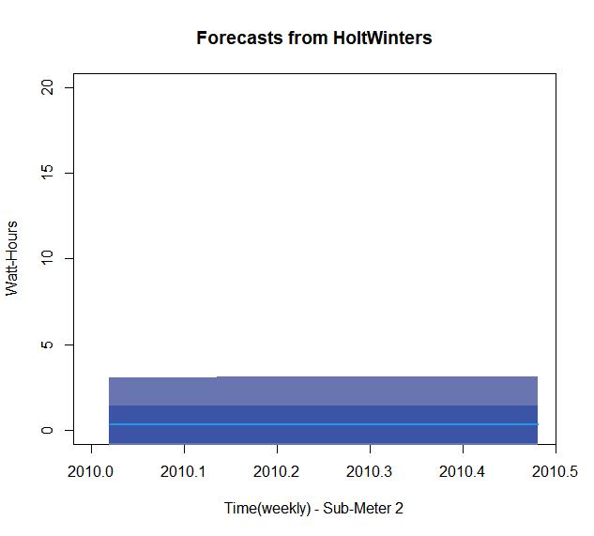

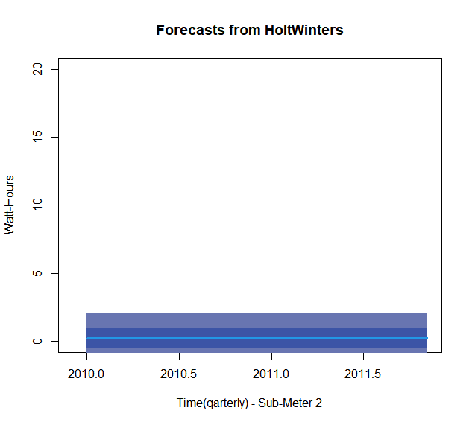
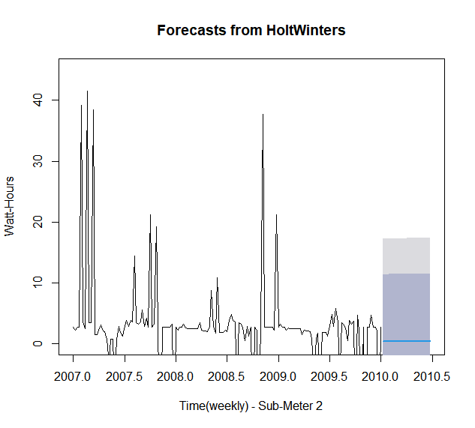
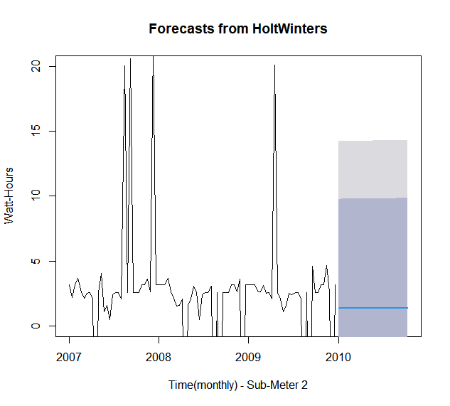
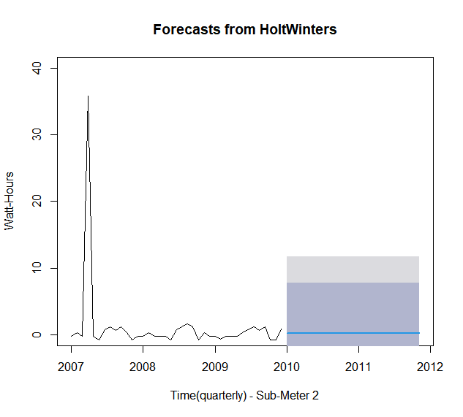
Holt Winter Forecast SM 2
P - value for all 3 frequencies for SM 2 were very low for HW forecast.

Slide 16
Conclusion
The goal of the project was to look at the trends in energy usage for a certain residence and find any patterns in consumption of energy for 3 different sub meters.
While we had a lot of observations in the data set it was hard to see a clear pattern in energy usage.
We would like to know if during data collections some of the appliances, A/C units and water heaters in particular, were out of order.
We would like to have the information if a resident occupied the building all the time during observed years 2007-2009

Slide 17
Recommendations
We would recommend splitting sub-meter 3 to A/C and water heater.
Look at the possibilities to use solar panels for some of the sub-meters.
Possibly switching the water electric heater to gas heater because it is cheaper to operate.
Build new residences with sun reflected windows.
Look at the more efficient sun reflected roofs while building new residences.
Install fans in all the rooms and encourage residents to use it since it cools the air while fans are operated.

